Slide 1
Capstone Engagement
Assessment, Analysis, and Hardening of a Vulnerable System

Slide 2
Table of Contents
This document contains the following sections:
01
Network Topology
02
Red Team: Security Assessment
03
Blue Team: Log Analysis and Attack Characterization
Hardening: Proposed Alarms and Mitigation Strategies
04

Slide 3
Network Topology
3

Slide 4
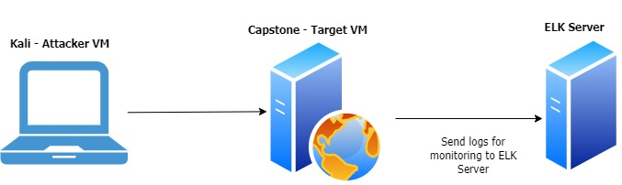
Network Topology
Network
Address Range: 192.168.1.0/24
Netmask:255.255.255.255
Gateway: 192.168.1.1
Machines
IPv4:192.168.1.90
OS: Linux
Hostname: Kali
IPv4:192.168.1.105
OS:Linux
Hostname:Capstone
IPv4:192.168.1.100
OS:Linux
Hostname:ELK

Slide 5

Red Team
Security Assessment
5

Slide 6
Recon: Describing the Target
Nmap identified the following hosts on the network:
Hostname | IP Address | Role on Network
Windows | 192.168.1.1 | It allows remote connections between internal systems on the network.
Elk | 192.168.1.100 | Elk Monitoring Server
Captsone | 192.168.1.105 | This system has Apache webserver running on it and is identified as target system to exploit the vulnerability.
Kali | 192.168.1.90 | This system is used to launch remote attack target system which is Capstone webserver.

Slide 7
Vulnerability Assessment
The assessment uncovered the following critical vulnerabilities in the target:
Vulnerability | Description | Impact
Sensitive Data Exposure (SDE) OWASP Top 10 #3 || Critical | The secret folder which contains sensitive information intended for authorised users is publicly visible | An attacker can brute_force credentails required for accessing secret folder and get sensitive information using which he can further break into the web server
Unauthorized File Upload Critical | Users can upload arbitrary files to the web server | This vulnerability allows attackers to upload to php scripts to the server and open backdoor to the system
Remote Code Execution via Command Injection OWASP Top 10 #1 || Critical | Due to unauthorized file upload vulnerability, attacker can upload arbitrary shell scripts and achieve remote code execution on the web server | Using this vulnerability, an attacker can open reverse shell to the server

Slide 8
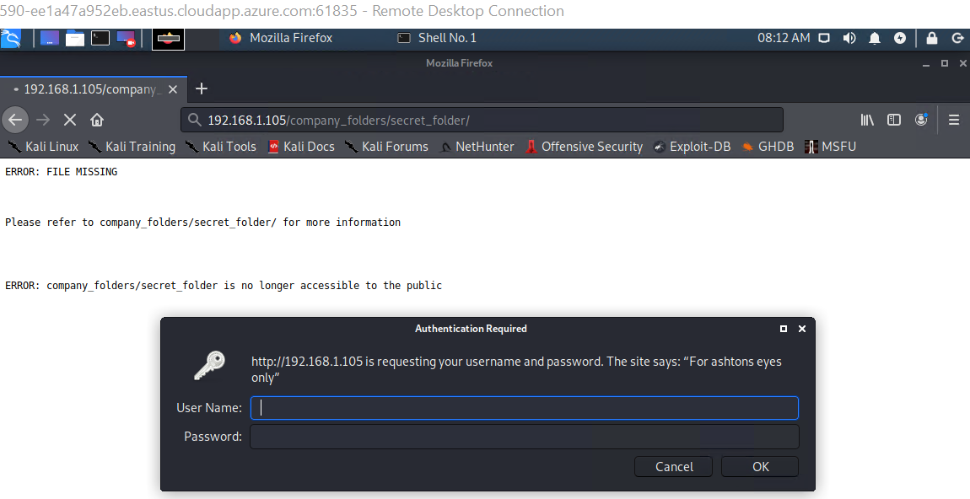
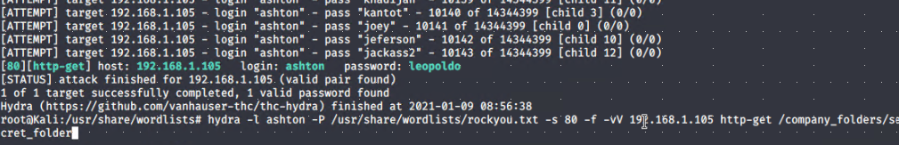
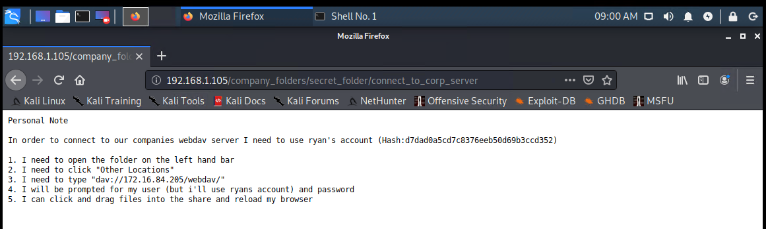
Exploitation: [Sensitive Data Exposure]
01
02
03
Exploitation
Accessed secret_folder and got sensitive information
Tools & Processes
Nmap – To scan network
Browser – To navigate and explore
Hydra – To perform brute force attack against secret folder and get password for user ashton
Achievements
Nmap scan revealed that capstone webserver is accessible via port 80
Navigation to webserver url ip using browser highlighted secret folder on the server which is password protected but susceptible to brute_force
Got password for user ashton by running hydra attack against secret directory

Slide 9
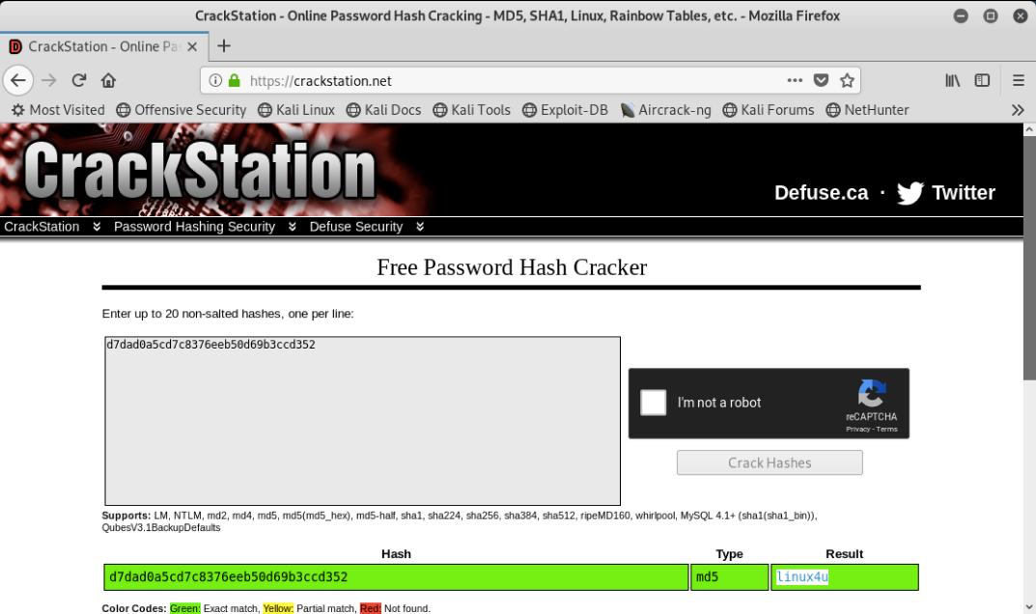
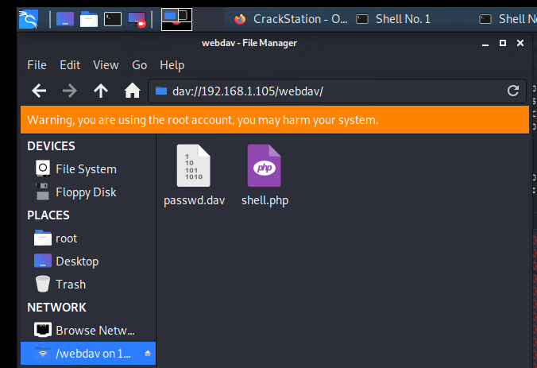
Exploitation: [Unauthorized File Upload]
01
02
03
Tools & Processes:
Crackstation – To break the password hash
Msfvenom – To create a customer payload to open a reverse shell to attacker
Upload shell via WebDAV
Achievements:
Logged into WebDAV server using stolen credentails and uploaded payload (shell.php) into the share folder.

Slide 10
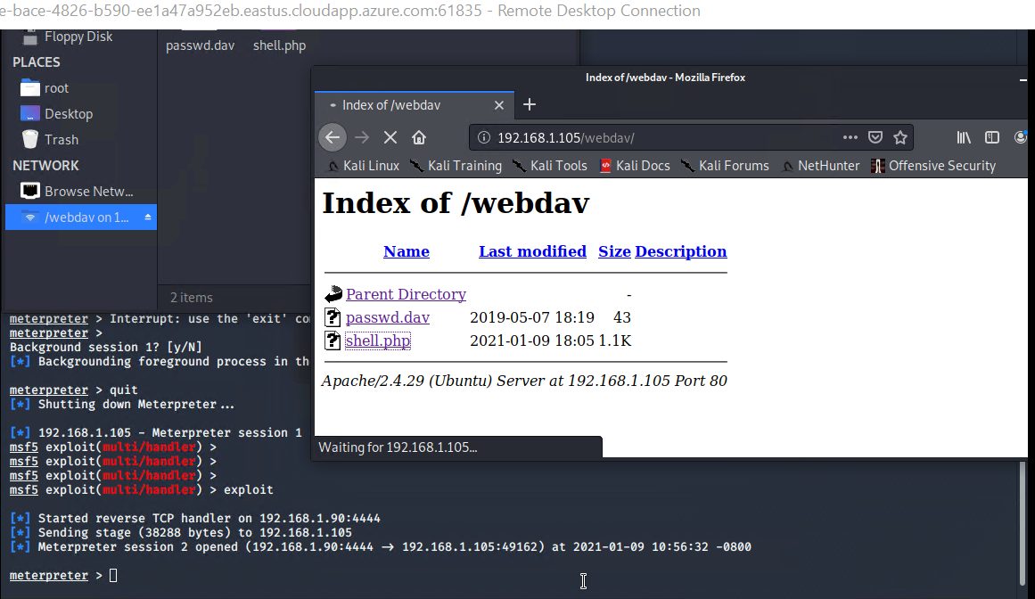
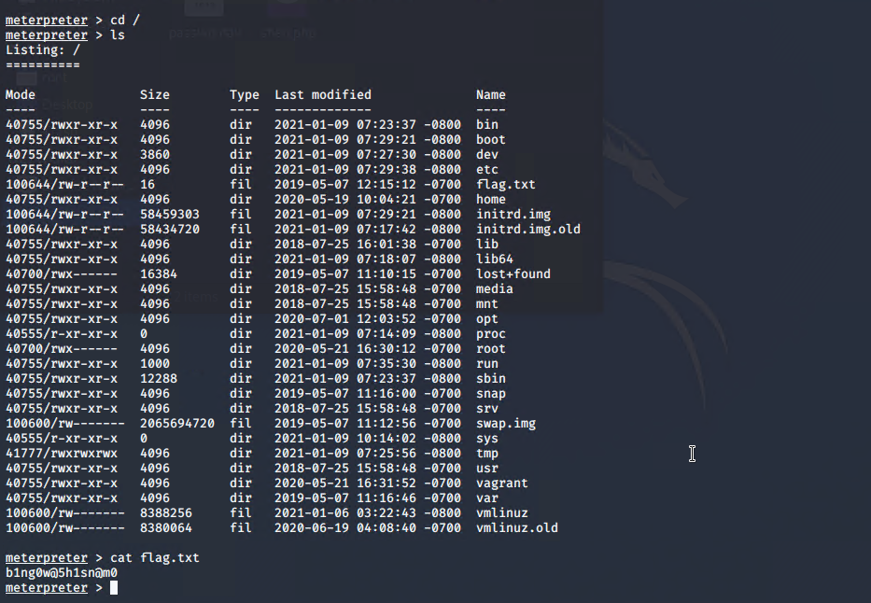
Exploitation: [Remote Code Execution]
01
02
03
Tools & Processes
Metasploit – To open meterpreter session to connect to target system once the uploaded payload is executed
Achievements
Leveraging the RCE
allows us to open a
Meterpreter shell to the
target
Achieving a shell on
the target allows us to
view all files and
capture the flag

Slide 11

Blue Team
Log Analysis and Attack Characterization
11

Slide 12
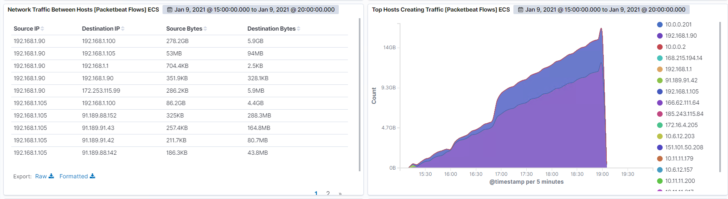
Analysis: Identifying the Port Scan
As seen in network traffic between hosts, spikes in traffice observed at 16:55 – 17:05. Source of the network traffic is source ip of attacking (kali) machine (192.168.1.90).

Slide 13
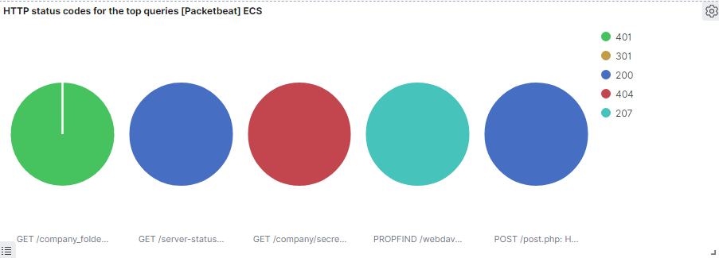
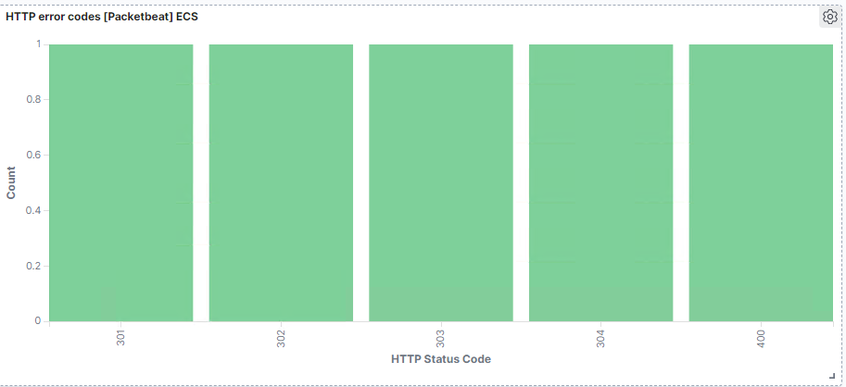
Response codes sent back by victim as 401, 301, 200 , 404 & 207 as seen in ‘HTTP status codes for the top queries [packetbeat] ECS dashboard panel.
Response code of 401 indicates that unauthorized access attempt was made to secret_folder several times. 200 (OK ), 301(Moved permanently), 404(Not Found) & 207(Multi-Status)

Slide 14
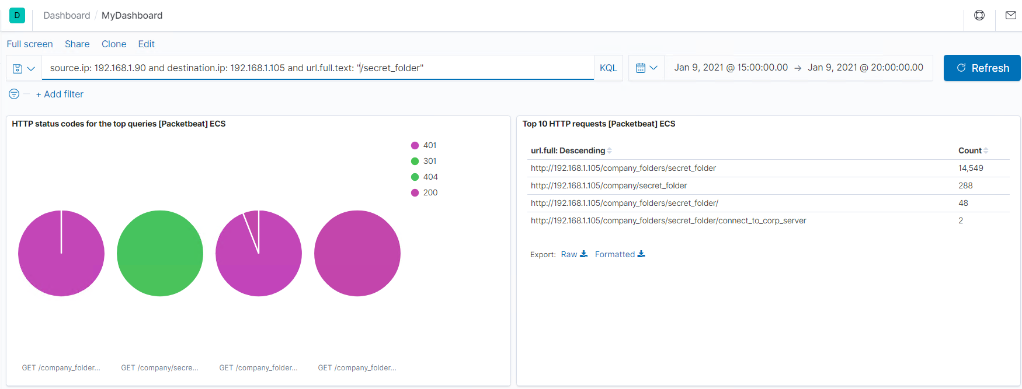
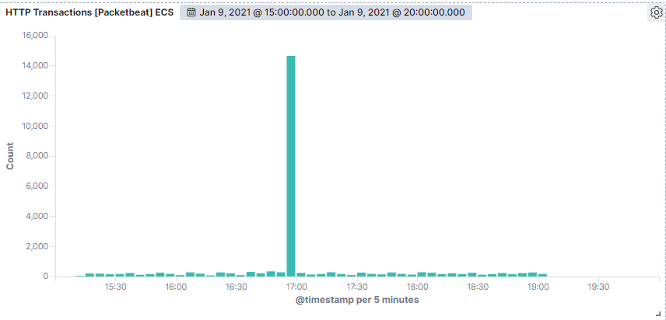
Analysis: Finding the Request for the Hidden Directory
As seen in the Top HTTP requests dashboard, secret_folder was accessed 14,549 times from source ip address 192.168.1.90 which is attacker’s machine.
File name ‘connect_to_corp_server’ from secret_folder was requested 2 times. This file has instructions on how to connect to the WebDAV directory, as well the user's username and hashed password.
HTTP Transactions shows that it occurred between 16:55 to 17:05.

Slide 15
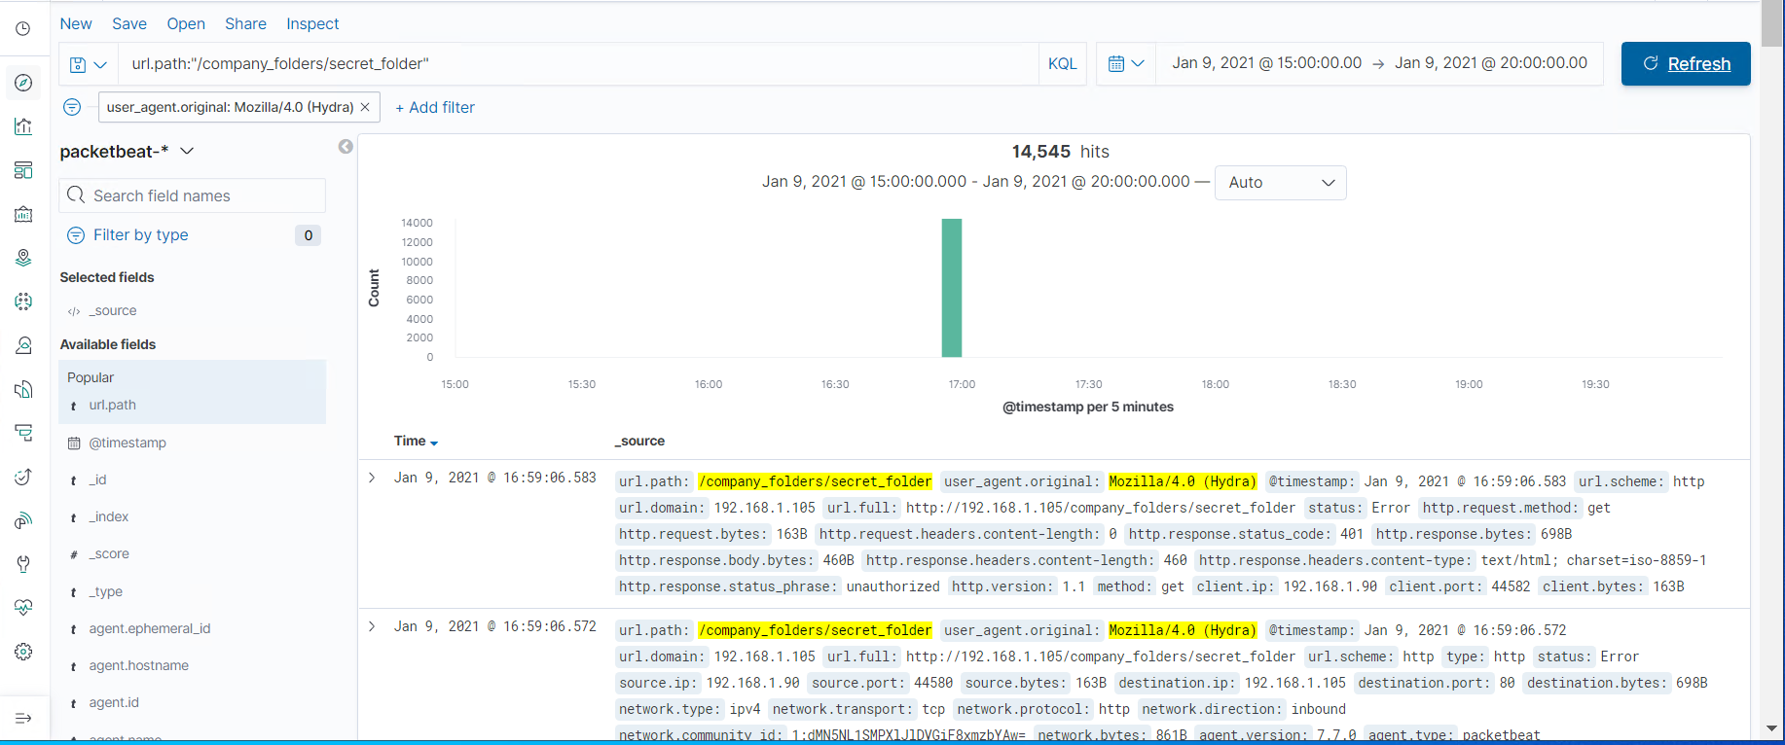
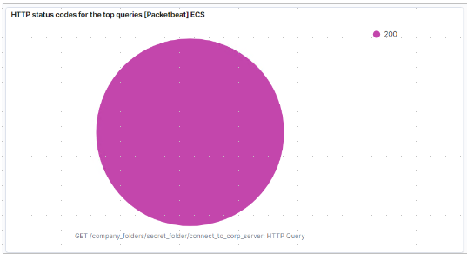
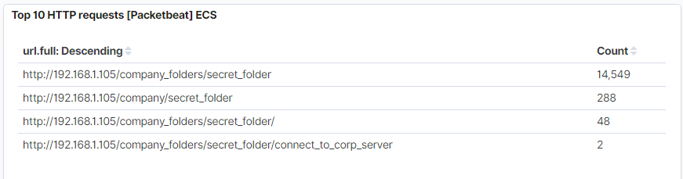
Analysis: Uncovering the Brute Force Attack
Top 10 HTTP requests [Packetbeat] ECS panel, contain evidence of large number of requests to sensitive secret_folder; but only 2 attempts were successful. This is a telltale signature of a brute-force attack.
Searching for url.path: ”/company_folders/secret_folder” shows the results from brute-forcing tool Hydra, which is identified by user_agent.original : Mozilla/4.0 (Hydra)

Slide 16
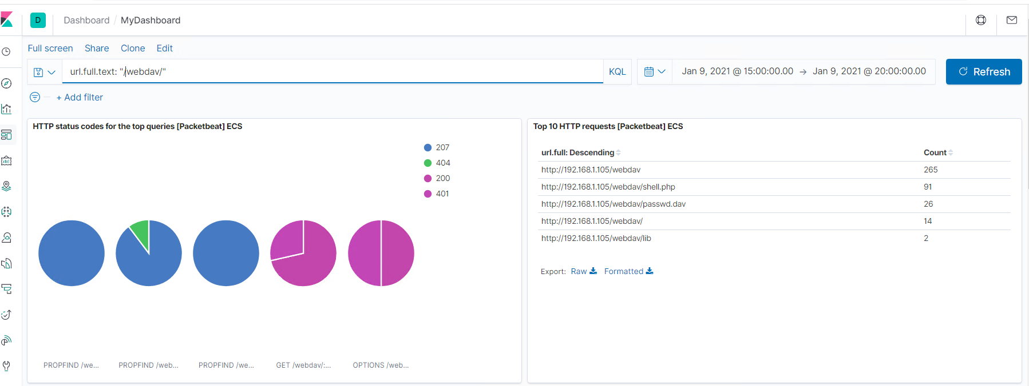
Analysis: Finding the WebDAV Connection
Top 10 HTTP requests[packetbeat] ECS panel shows that attacker was able to access password protected webdav directory 265 times.
Shell.php inside webdav folder was accessed 91 times & passwd.dav was accessed 26 times.

Slide 17
Blue Team
Proposed Alarms and Mitigation Strategies
17

Slide 18
Mitigation: Blocking the Port Scan
What kind of alarm can be set to detect future port scans?
Alarm to monitor number of requests per second
What threshold would you set to activate this alarm?
Alarms should be triggered if source IP address sends more than 25 requests per second for more than 5 seconds
What configurations can be set on the host to mitigate port scans?
The local firewall can be used to throttle incoming connections
ICMP traffic can be filtered
An IP whitelist can be enabled
Rate limiting traffic from single source in specified timeframe
Describe the solution. If possible, provide required command lines.
If client makes too many requests within a given time frame, HTTP servers can respond with status code 429: Too Many Requests.

Slide 19
Mitigation: Finding the Request for the Hidden Directory
What kind of alarm can be set to detect future unauthorized access?
Alarm should be triggered if unauthorized user attempt to access sensitive data.
Alarm should be triggered if source of an access request is not from the permitted list of ip addresses allowed to access sensitive data.
What threshold would you set to activate this alarm?
This is a binary alarm: It would be activated if the incoming IP is not whitelisted or user is not in permitted list of users.
What configuration can be set on the host to block unwanted access?
Secret_folder should be moved to system with strict access controls like key-based SSH access from whitelisted ip addresses
Only authorized users should be able to access sensitive data
In addition, inside file should be encrypted at rest.
Filebeat should be configured to monitor and log access to secret_folder directory & its content.

Slide 20
Mitigation: Preventing Brute Force Attacks
What kind of alarm can be set to detect future brute force attacks?
Alarm for error code 401 (Unauthorized client)
Excessive amount of bandwidth over the course of single session
What threshold would you set to activate this alarm?
More than 100 responses per second for 5 seconds should trigger the alarm
Sudden spike in BW consumption than the usual baseline should trigger the alarm for investigation.
What configuration can be set on the host to block brute force attacks?
Configuring fail2ban or a similar utility would mitigate brute force attacks

Slide 21
Mitigation: Detecting the WebDAV Connection
What kind of alarm can be set to detect future access to this directory?
Access from source IP’s other than whitelisted ip addresses
Login failed events for webdav directory should be monitored
Monitor access to webdav with Filebeat
What threshold would you set to activate this alarm?
Access from source ips not listed in whitelisted ip addresses would trigger the alarm.
More than 2 consecutive failed login attempts to webdav directory would lockout the account until enabled by administrator
What configuration can be set on the host to control access?
Administrators must install and configure Filebeat on the host.
Deny access to RDP ports from external network

Slide 22
Mitigation: Identifying Reverse Shell Uploads
What kind of alarm can be set to detect future file uploads?
Alarms should trigger upon receipt of any POST request containing form or file data of a disallowed file type,
e.g., .php.
What threshold would you set to activate this alarm?
The alarm should fire whenever users upload a forbidden file.
What configuration can be set on the host to block file uploads?
Write permissions can be restricted on the host
Uploads can be isolated into a dedicated storage partition.
File uploads should require authentication
Implement upload filter on server by disallowing users to upload files containing executable scripts codes

